Slide 1
Relaxation Through Art:
a lesson on zentangles
By: Kaitlin Nokes

Slide 2
Lesson Summary
Students learn about benefits of relaxation and explore different methods
Students learn about patterns and artist Yayoi Kusama
Students create zentangles using patterns and vivid colors
Students write a reflection on their experience zentangling
Students analyze a partner’s artwork

Slide 3
Content Areas Integrated
Visual Art…
Learn about the artist Yayoi Kusama and the theme used in her art (patterns)
Create zentangles using different patterns
Analyze artwork
Literacy…
Write a reflection paragraph
Connect emotions to artwork
Health Science…
Practice relaxation techniques
Think about other ways to de-stress
Describe the benefits to relaxing

Slide 4
Essential Questions
What are some ways that people can relax?
Why is relaxing important?
How do you analyze artwork?
What emotions are felt while creating art?

Slide 5
Opening Activity
Group discussion on relaxation techniques
Prior knowledge
Video on zentangling

Slide 6
Day 1
Discuss methods of relaxation
Introduce zentangling (video)
Show photos of artwork by Yayoi Kusama (patterns/color)
Play relaxing music
Start zentangle outlines and choose color
Start patterns in their different sections

Slide 7
Day 2
Pass back zentangles
Play relaxing music
Closing
Self reflection paragraphs
Did you like zentangling?
What emotions did you feel while doodling?
Why did you choose to do the color that you did?
Would you want to zentangle again?
Partner analyzing
What do you think s/he was feeling while creating this piece?
What is the purpose of the color or patterns?

Slide 8
Summative Assessment
Two written reflections
Answered all of the questions
Zentangle
Use of patterns within the shape

Slide 9
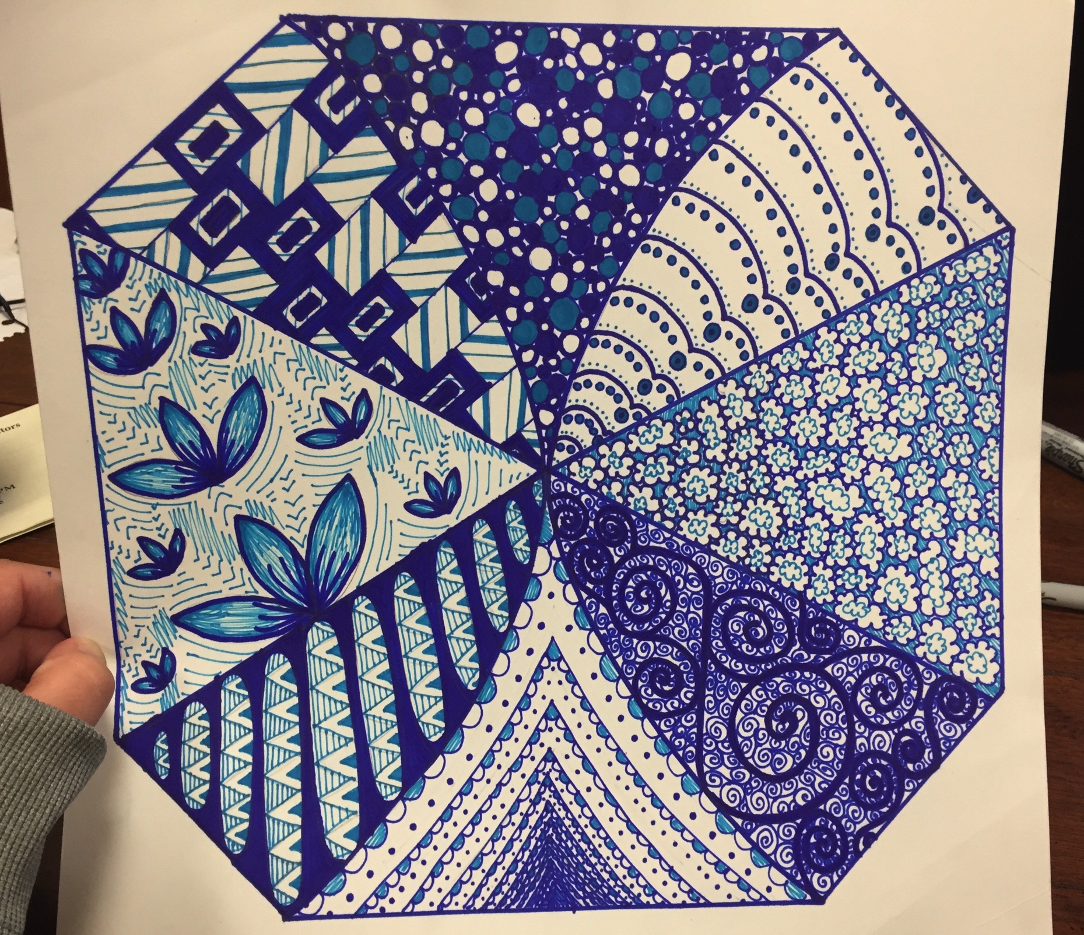
Example

